Slide 1

Query processing architecture and cost-based query optimization
Database Management System | Storage Structures, Indexing and Query Optimization
Course: Database Management System (DBMS) | Chapter: Storage Structures, Indexing and Query Optimization | Program: B.TECH-CSE, B.TECH CSE - CYBER SECURITY, B.TECH CSE - DATA
DISCOVER · LEARN · EMPOWER
Notes:
Welcome everyone to this session on Query Processing. We are diving deep into how databases actually execute your SQL commands. Today we focus specifically on the architecture that turns a query into a result and the math behind choosing the fastest path. Remember, efficient query processing is the backbone of any responsive database system.

Slide 2
Course Outcomes
SLIDE 2 / 14
Course Outcome
CO | BT LEVEL | DESCRIPTION
CO1 | BT2 | Explain database architecture, relational model concepts and formal query language foundations including relational algebra and relational calculus.
CO2 | BT3 | Apply relational algebra, relational calculus and SQL constructs to formulate correct and efficient database queries.
CO3 | BT4 | Analyze functional dependencies and design normalized relational schemas up to 5NF ensuring lossless join and dependency preservation.
CO4 | BT4 | Analyze transaction schedules and concurrency control mechanisms to determine serializability, recoverability and correctness.
CO5 | BT5 | Evaluate storage structures, indexing strategies and query optimization techniques for performance, scalability and reliability.
Chandigarh University
2 / 14
Notes:
Let's map our learning to the course outcomes. CO2 is directly addressed as we learn to formulate efficient queries using relational algebra. CO3 is the foundation, as our optimization strategies rely on the normalized schemas we designed earlier. Together, these outcomes ensure you can build and tune robust database systems.

Slide 3
Learning Objectives
SLIDE 3 / 14
Learning Outcomes
1
Analyze the four distinct phases of the query processing architecture.
2
Evaluate the role of the query optimizer in selecting execution plans.
3
Calculate the estimated cost of different join algorithms using tuple counts.
4
Compare the performance implications of nested-loop versus hash join strategies.
5
Identify common pitfalls in cost estimation that lead to suboptimal plans.
Chandigarh University
3 / 14
Notes:
By the end of this lecture, you will be able to analyze the query processing pipeline. You will evaluate how the optimizer chooses between different join methods. We will calculate costs using simple formulas to see why one plan is better than another. Finally, we will identify why cost estimation can sometimes go wrong.

Slide 4

Lecture
SLIDE 4 / 14
Query Processing Architecture Overview
IT CONSISTS OF FOUR SEQUENTIAL PHASES
Parsing, Normalization, Optimization, and Execution.
• The architecture transforms a high-level SQL query into an executable plan.
• Parsing checks syntax and builds a parse tree representing the query structure.
• Normalization rewrites the query into an equivalent canonical form for analysis.
• Optimization generates multiple candidate plans and selects the lowest cost one.
• Execution runs the chosen plan to retrieve the final result set.
Perception Of Four Arrow Stages Basic Process Flow Chart PowerPoint Templates
Chandigarh University
4 / 14
Notes:
Think of this architecture as a factory assembly line. First, the parser checks if your SQL is grammatically correct. Then, normalization simplifies the query, much like reducing a fraction. The optimizer is the manager deciding the best route. Finally, the execution engine does the heavy lifting to fetch data.

Slide 5
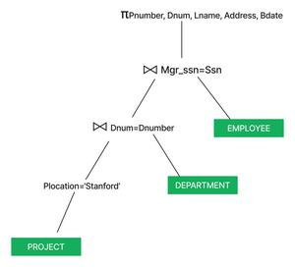
Lecture
SLIDE 5 / 14
Parsing and Normalization Phases
1
Parsing converts the SQL string into a tree structure called a parse tree.
2
Semantic analysis verifies table names and column types against the catalog.
3
Normalization transforms the query into a canonical form like conjunctive normal form.
4
This phase simplifies complex expressions and removes redundant logical operators.
5
The output is a query tree that represents the logical operations required.
6
This logical representation is independent of the physical storage details.
Source: media.geeksforgeeks.org
Chandigarh University
5 / 14
Notes:
During parsing, the system builds a tree where the root is the main operation like SELECT. Normalization then simplifies this tree, for example, turning a complex OR condition into a simpler form. This ensures the optimizer works with a clean, standardized logical representation. It is crucial because the optimizer cannot work efficiently on messy, unstructured SQL.

Slide 6
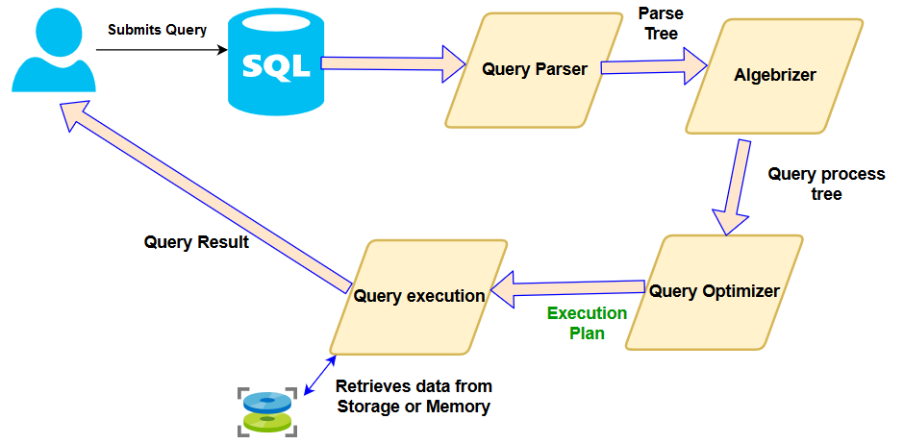
Lecture
SLIDE 6 / 14
The Role of the Query Optimizer
1
The optimizer is the brain that selects the most efficient execution strategy.
2
It generates multiple equivalent plans for the same logical query.
3
Cost estimation uses statistics to predict the resource usage of each plan.
4
The optimizer chooses the plan with the minimum estimated execution cost.
5
It considers factors like I/O operations, CPU cycles, and memory usage.
6
Without optimization, the database might execute a query in minutes instead of seconds.
Source: s38063.pcdn.co
Chandigarh University
6 / 14
Notes:
The optimizer is the most critical component for performance. It looks at a single query and generates dozens of possible ways to execute it. For instance, it might choose to scan a table or use an index. It then calculates the cost of each path. The goal is always to minimize the total time and resources required.

Slide 7
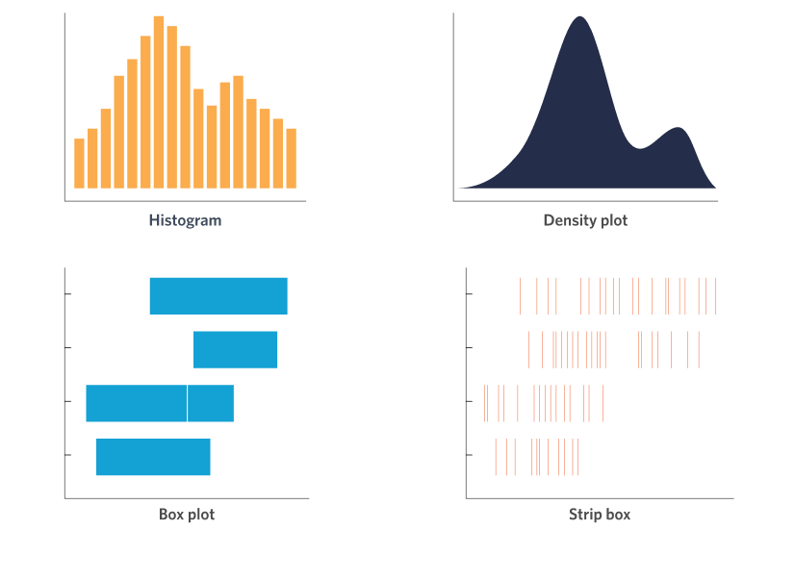
Lecture
SLIDE 7 / 14
Cost-Based Optimization Principles
1
Cost-based optimization relies on statistical data about the database relations.
2
Key statistics include the number of tuples, number of pages, and distinct values.
3
The optimizer estimates the cost of an operation based on these statistics.
4
Cost is typically measured in terms of disk I/O operations required.
5
CPU cost is also considered but I/O is usually the dominant factor.
6
Accurate statistics are essential for the optimizer to make correct decisions.
Source: culturecounts.cc
Chandigarh University
7 / 14
Notes:
The optimizer needs data to make decisions. It looks at how many rows are in a table or how many unique values exist in a column. If a column has low selectivity, an index might be useless. If it has high selectivity, an index is likely the best choice. Without these statistics, the optimizer is flying blind.

Slide 8
Lecture
SLIDE 8 / 14
Join Algorithm Selection Strategies
1
Nested-loop join is simple but expensive for large datasets without indexes.
2
Index-based join uses existing indexes to speed up the matching process.
3
Hash join builds a hash table on the smaller relation for fast lookups.
4
Sort-merge join requires both relations to be sorted on the join key.
5
The optimizer selects the algorithm based on available indexes and data size.
6
Choosing the wrong join algorithm can lead to quadratic time complexity.
Chandigarh University
8 / 14
Notes:
When joining two tables, the optimizer has several tools. Nested-loop is like checking every student against every grade. Hash join is faster, like putting grades in a bucket and looking them up instantly. Sort-merge is useful when data is already sorted. The choice depends entirely on the data size and available indexes.

Slide 9
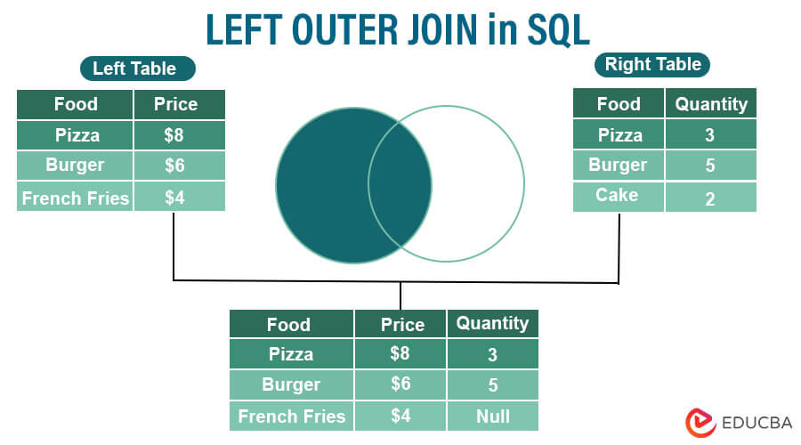
Worked Example
SLIDE 9 / 14
Cost Calculation
GOVERNING EQUATION
Cost of Nested-Loop Join = Tuples(R) × Tuples(S) = 1000 × 500 = 500,000
1
Assume Relation R has 1000 tuples and Relation S has 500 tuples.
2
Cost of Index Nested-Loop = Tuples(R) × (Log₂(Index_S) + 1) ≈ 1000 × 10 = 10,000.
3
Cost of Hash Join = Tuples(R) + Tuples(S) + Probes = 1000 + 500 + 1000 = 2500.
4
The optimizer compares these costs to select the Hash Join as optimal.
5
This example shows how index usage drastically reduces the estimated cost.
Source: cdn.educba.com
Chandigarh University
9 / 14
Notes:
Let's do a quick calculation. If we have 1000 rows in R and 500 in S, a nested loop is 500,000 operations. That is huge. But if we use an index, it drops to 10,000. A hash join might only take 2,500 operations. This numerical difference clearly shows why the optimizer prefers the hash join here.

Slide 10
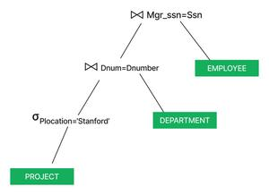
Lecture
SLIDE 10 / 14
Selectivity and Predicate Pushdown
1
Selectivity measures the fraction of tuples that satisfy a selection condition.
2
High selectivity means few tuples match, making indexes highly effective.
3
Predicate pushdown moves selection conditions as early as possible in the plan.
4
This reduces the number of tuples processed by subsequent join operations.
5
The optimizer reorders operations to minimize intermediate result set sizes.
6
Early filtering is a key strategy for reducing overall query cost.
Source: media.geeksforgeeks.org
Chandigarh University
10 / 14
Notes:
Selectivity tells us how many rows will pass a filter. If only 1% of rows match, an index is perfect. Predicate pushdown is a technique where we apply filters as early as possible. Instead of joining two large tables and then filtering, we filter first. This drastically reduces the amount of data we need to process.

Slide 11
Lecture
SLIDE 11 / 14
Common Pitfalls in Cost Estimation
1
Outdated statistics can lead the optimizer to choose a poor execution plan.
2
Assuming uniform data distribution often fails for skewed or clustered data.
3
Ignoring correlation between columns can result in inaccurate selectivity estimates.
4
Over-reliance on I/O cost may neglect CPU bottlenecks in modern systems.
5
Complex queries with many joins can lead to exponential plan search spaces.
6
Manual hints may override the optimizer's best judgment in specific cases.
Chandigarh University
11 / 14
Notes:
There are common traps. If your statistics are old, the optimizer might think a table is small when it is huge. It often assumes data is evenly distributed, which is rarely true. Skewed data can break these assumptions. Also, modern CPUs are fast, so sometimes I/O isn't the only bottleneck. Being aware of these pitfalls helps you tune your database better.

Slide 12
Lecture
SLIDE 12 / 14
Impact of Indexing on Optimization
1
Indexes provide a direct path to data, reducing the need for full scans.
2
The optimizer prefers index scans over table scans when selectivity is high.
3
Composite indexes can satisfy multiple conditions in a single query.
4
Too many indexes can slow down write operations and increase storage cost.
5
The optimizer balances read performance against write overhead during planning.
6
Proper indexing is a prerequisite for effective cost-based optimization.
Chandigarh University
12 / 14
Notes:
Indexes are the fuel for optimization. They allow the database to skip rows it doesn't need. If you have a high selectivity query, an index is almost always better. However, indexes are not free; they slow down inserts and updates. The optimizer must balance the speed of reads against the cost of maintaining these structures.

Slide 13
Lecture
SLIDE 13 / 14
Key Takeaways
1
Query processing involves parsing, normalization, optimization, and execution phases.
2
The optimizer selects the lowest cost plan using statistical data.
3
Join algorithms like Hash and Index-Nested-Loop offer significant performance gains.
4
Accurate statistics and proper indexing are critical for optimal query plans.
5
Understanding cost estimation helps identify and avoid common performance pitfalls.
Chandigarh University
13 / 14
Notes:
To summarize, remember the four phases of query processing. The optimizer is the key to performance, using statistics to choose the best plan. Join algorithms and indexing are powerful tools, but they require accurate data. Finally, always be aware of the pitfalls in estimation to ensure your queries run efficiently.

Slide 14
Lecture
SLIDE 14 / 14
References
1
Fundamentals of Database Systems — Ramez Elmasri & Shamkant B. Navathe
2
Database System Concepts — Silberschatz, Korth & Sudarshan
3
Database Management Systems — Raghu Ramakrishnan & Johannes Gehrke
4
Oracle/MySQL Documentation — Oracle
Chandigarh University
14 / 14
Notes:
These are the standard texts we recommend for further reading. Elmasri and Navathe provide a deep theoretical foundation. Silberschatz offers a comprehensive overview of system concepts. Ramakrishnan is excellent for practical implementation details. Oracle documentation is essential for specific syntax and features. Please review these chapters to deepen your understanding.

